Slide 1
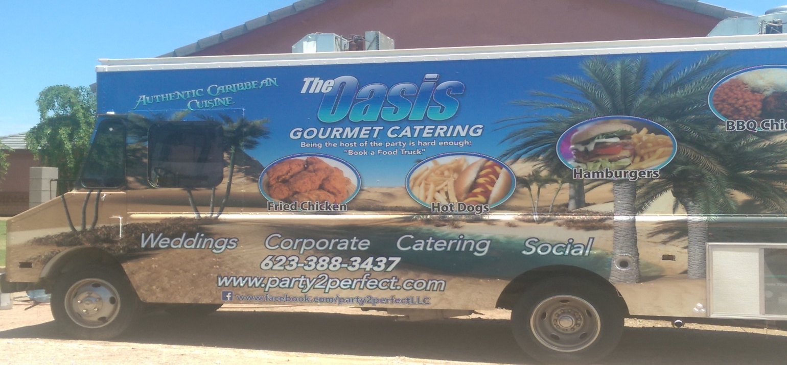
THE OASIS
GOURMET CATERING
CATERING MENU
Notes:
The Oasis Gourmet Catering food truck is not your typical food truck. We are actually a mobile kitchen with the capability of serving an array of theme menu. Not all items are available on a daily basis. We have a core menu ( BBQ Chicken, Jerk Chicken, Griot, with all the sides) that is available whenever the truck is on the road, and we customize our load to better suited our destination.

Slide 2
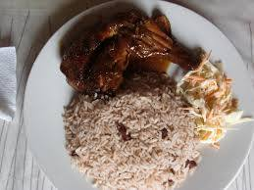
JERK CHICKEN
Jerk Marinated Oven Roasted Quarter Leg of Chicken
Served with a choice of
* Rice and Beans * Haitian Black Rice
Notes:
What is Haitian Black Rice? Haitian Black Rice a/k/a Diri ak djon djon , Haitian Creole for rice with mushrooms, is a native dish of Haiti. It is essentially a meal consisting of rice and edible black mushrooms called "djon djon". The meal is more common in the northern region of the country and therefore can be considered a regional delicacy. When boiled, they release a gray-black coloring, giving this recipe and many others a distinctive aroma, flavor and color

Slide 3
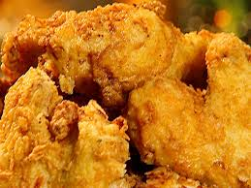
Caribbean Style Fried Chicken
Creole Spice Marinated Chicken ( Legs and Thighs Only)
Served with
Fried Plantain
Or
Rice and Beans
Notes:
Chicken is twice cooked.

Slide 4
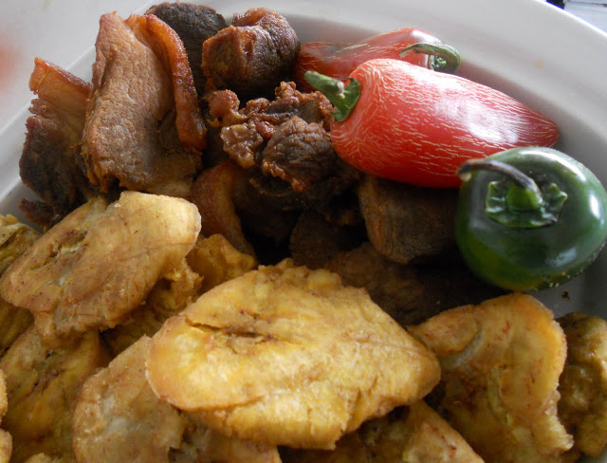
THE GRIOT “FRIED PORK”
Chunks of Pork Shoulder marinated in citrus and scotch bonnet chiles, simmered until very tender before being fried crisp and brown.
Served with
Fried Plantains
Or
Haitian Black Rice
Notes:
Native dish of HAITI. The secret of this dish is the of “sour orange” in the marinade.

Slide 5
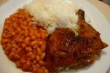
OASIS BBQ CHICKEN
Oasis Blend Spice marinated quarter Leg of Chicken smoked for at least 2 hours then drenched in the Oasis BBQ Sauce before finish it in the oven.
Served with
White Rice and the Oasis Baked Beans
Notes:
Oh yes! We have our own smoker.

Slide 6
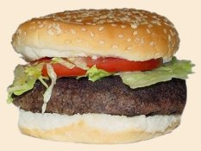

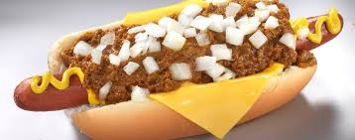

THE BACKYARD BARN
Traditional backyard offerings Such as
Hambugers: 80% lean
Our Vegetables are from the Local Farmers Market ( mainly organic produce )
Hot Dogs: all Beef
We serve our Dogs in more way than one; from plain Hot Dog to the Oasis Loaded Dogs
Which is :
Hot Dog topped with pulled pork, Oasis baked beans, Onions and Cheese
Notes:
Having a kid Birthday Party , The Oasis Gourmet Catering is the answer. We pull up right by your drive way or by the park where the party is being held. We serve from the truck.

Slide 7
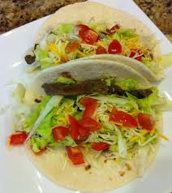
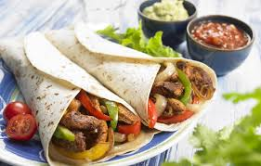
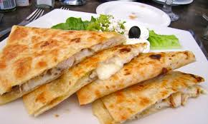
TASTE OF THE SOUTHWEST
We also offer theme menu.
We keep it simple but absolutely delicious.
Notes:
This a lunch crowd pleaser.

Slide 8
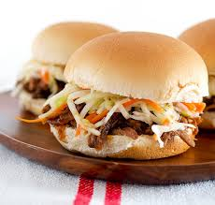
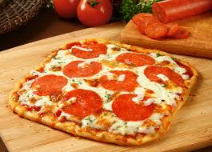
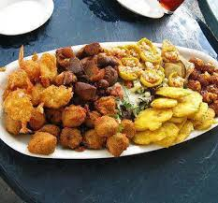
LATE NIGHT AFFAIR
Fritay:
Fritay is actually a divine array of fried food . Although this menu can be by it self a meal, but fritay is usually an after glow affair. the items in fritay are:
fried plantains, Acra, Marinades, Griot, Saucisse( Fried Hot Dogs),
Sliders:
Is it the sweet rolls we used or the slaw we use or the sauce we use? You just can not eat one.
Notes:
This Menu is best suited for an after dance party or perhaps for a wedding late night snack.

Slide 9
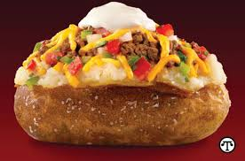
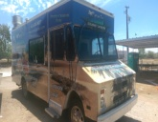
MOVING TO YOUR NEW OFFICE?
Loaded Baked Potato
Yukon Idaho Potato
Chili Sauce
Sour Cream
Cheddar Cheese
Bacon Bits
Notes:
Grand Opening or just moving to a new location?

